Slide 1
Gradient-descent

Slide 2
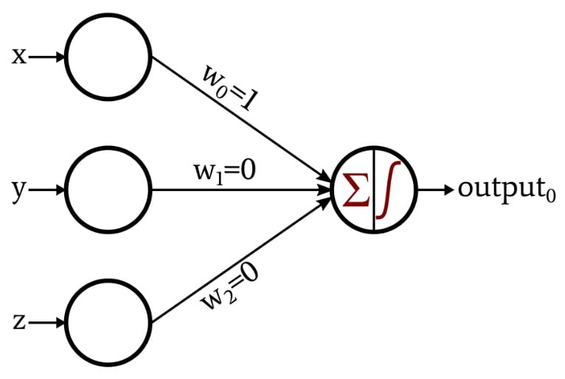
Perceptron Basic building block of Neural Networks

Slide 3
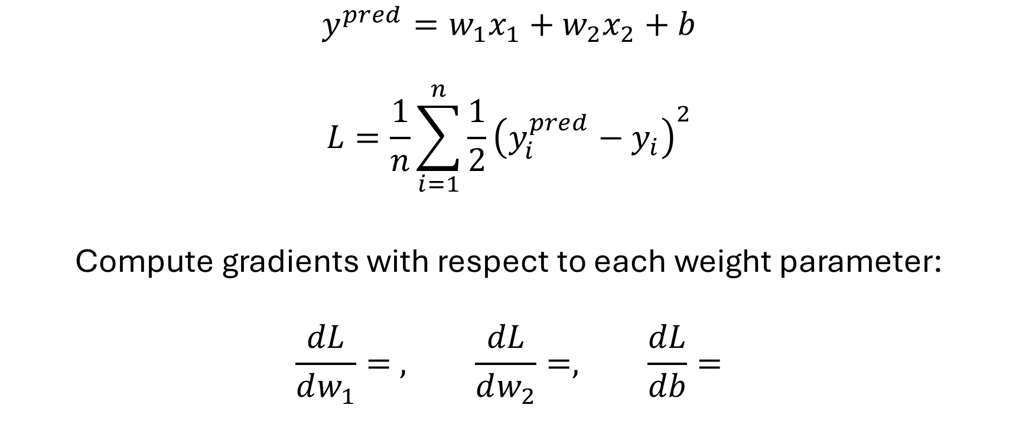
Loss function
$$y^{pred}=w_{1}x_{1}+w_{2}x_{2}+b$$
$$L=\frac{1}{n}\sum_{i=1}^{n}{\frac{1}{2}{\left(y_{i}^{pred}−y_{i}\right)}^{2}}$$
Compute gradients with respect to each weight parameter:
$$\frac{dL}{dw_{1}}= , \frac{dL}{dw_{2}}=, \frac{dL}{db}=$$

